Slide 1

Motion Detection Security Camera Project
User Manual
Author: Varenya Sharma
Notes:
Preworks course home assignments

Slide 2
Table of Contents
Acknowledgements
About the Creator
Clevered Internship Journey
About the App/Project
Guide to Use the App
Contact Information

Slide 3
Acknowledgements
I would like to thank my mentors and teachers, who have assisted me in making this project come to life. Ms. Shivani and Ms. Smita have guided me in all aspects of this project, alongside Ms. Shiksha and Mr Prateek. Moreover, I would like to express my gratitude to Mr Ken Kahn who oversaw this project and the app development process. Lastly, I would also like to mention a few websites which have aided in the creation of this app, such as www.geeksforgeeks.org

Slide 4

About Me..
My name is Varenya Sharma. I am a grade 11 student at the Heritage Xperiential Learning School in Gurgaon. I am passionate about the discipline of computer science and more specifically the world of artificial intelligence. Other than that, I enjoy playing sports such as soccer and cricket in my free time.

Slide 5
About My Internship Journey with Clevered..
My experience working with Clevered and making this project has been wonderful. It has been a learning and educational journey, with my mentors guiding me throughout the process. The sessions have been very interactive and fun and my teachers have been very supportive through this journey. The internship was challenging but very helpful in improving my computational thinking skills and teaching me practical skills which I can implement when I join the workforce.

Slide 6

About App..
The motion detection security camera project is designed to help users detect burglars or intruders and help in creating a safer environment for the users. The apps simple functionalities assist users by ringing an alarm when a security camera detects motion hence helping them safeguard their communities

Slide 7
How do I use the App?

Slide 8
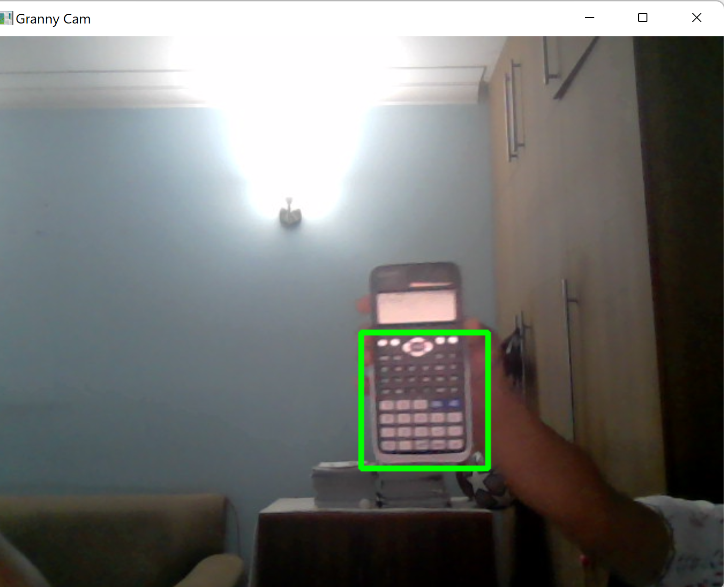
Steps to Use The App
When you press the “start” button the webcam turns on
When motion is detected in the webcam, an alarm goes off and a contour is created around the moving object
Press “q” to turn off the webcam

Slide 9
Contact Person
You can reach out to Varenya Sharma at varenyash@gmail.com for any questions/ concerns/ suggestions on the App

Slide 10
Thank you!

